Slide 1

DP-100 Microsoft Azure Data Science
https://learn.microsoft.com/en-us/credentials/certifications/azure-data-scientist/?practice-assessment-type=certification
Title Page
DP-100 Azure Data Scientist Associate

Slide 2
DP-100 Microsoft Azure Data Science
https://learn.microsoft.com/en-us/training/paths/design-machine-learning-solution/
Section 1
Design a machine learning solution

Slide 3
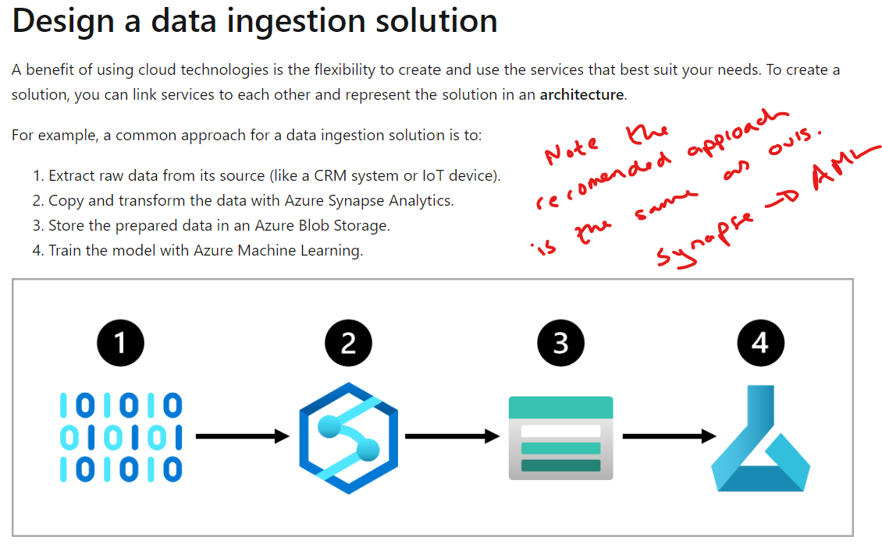
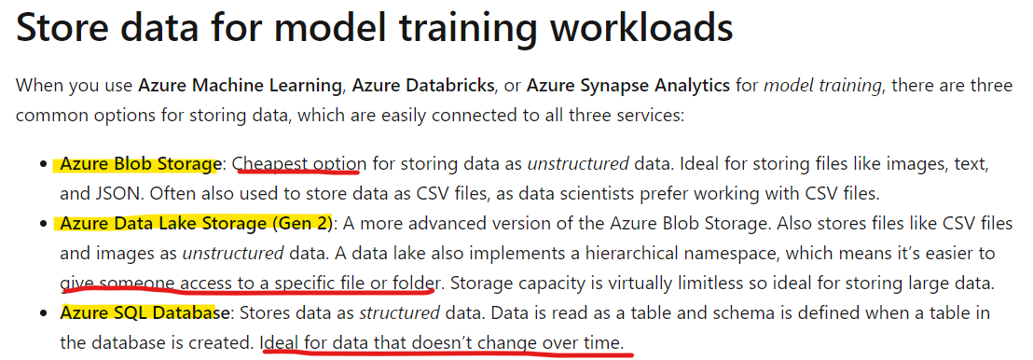
DP-100 Microsoft Azure Data Science
Microsoft Azure Data Science: Design a machine learning solution
Date: 18/10/24
Data Ingestion Strategy for ML Projects
Data Storage & Ingestion
Data Ingestion Pipelines
Azure Synapse: With Azure Synapse Pipelines you can create and schedule data ingestion pipelines
Azure Databricks: More of a managed service than synapse but very similar.
Azure Machine Learning: Though Azure Machine Learning pipelines are commonly used to train machine learning models, you could also use it to extract, transform, and store the data in preparation for training a machine learning model.
https://learn.microsoft.com/en-us/data-engineering/playbook/articles/databricks-vs-synapse

Slide 4
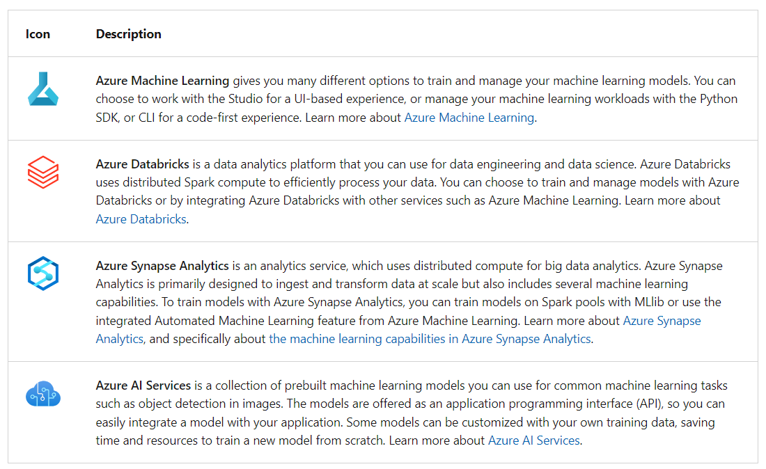
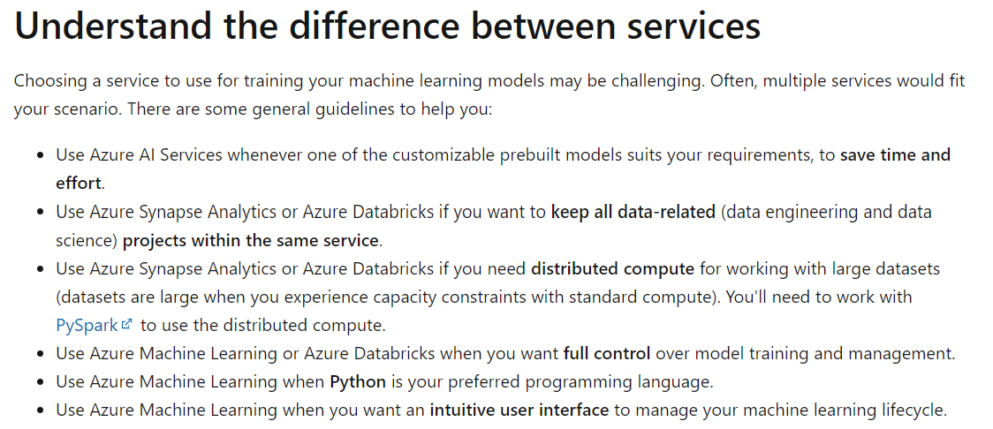
DP-100 Microsoft Azure Data Science
Microsoft Azure Data Science: Design a machine learning solution
Date: 18/10/24
Design an ML Model Training Solution
Choosing the Right Service

Slide 5
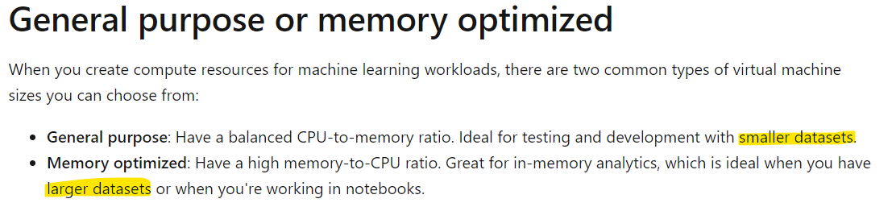
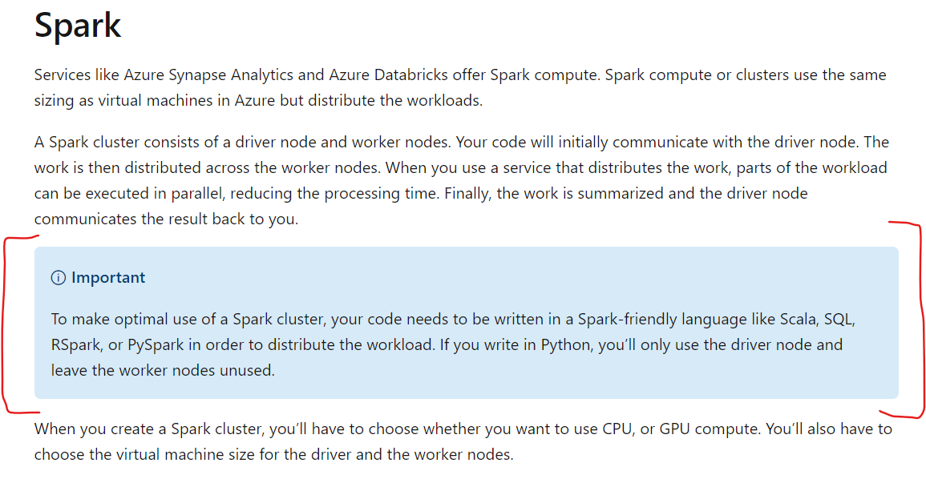
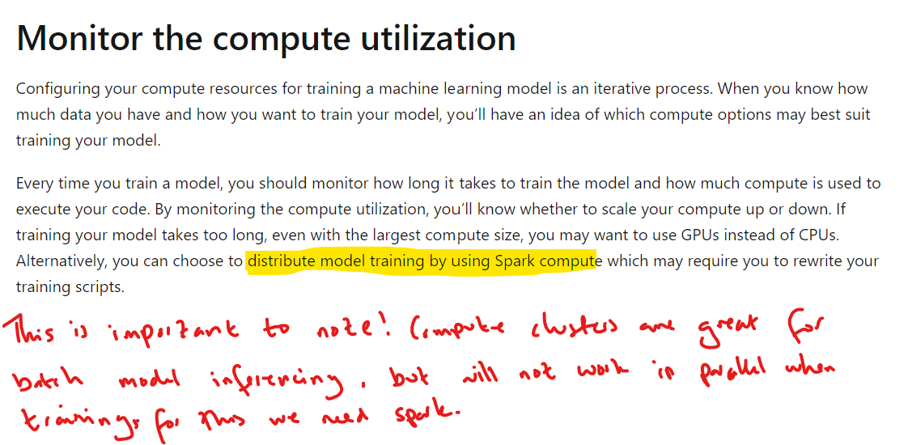
DP-100 Microsoft Azure Data Science
Microsoft Azure Data Science: Design a machine learning solution
Date: 18/10/24
Design an ML Model Training Solution
Deciding on Compute

Slide 6
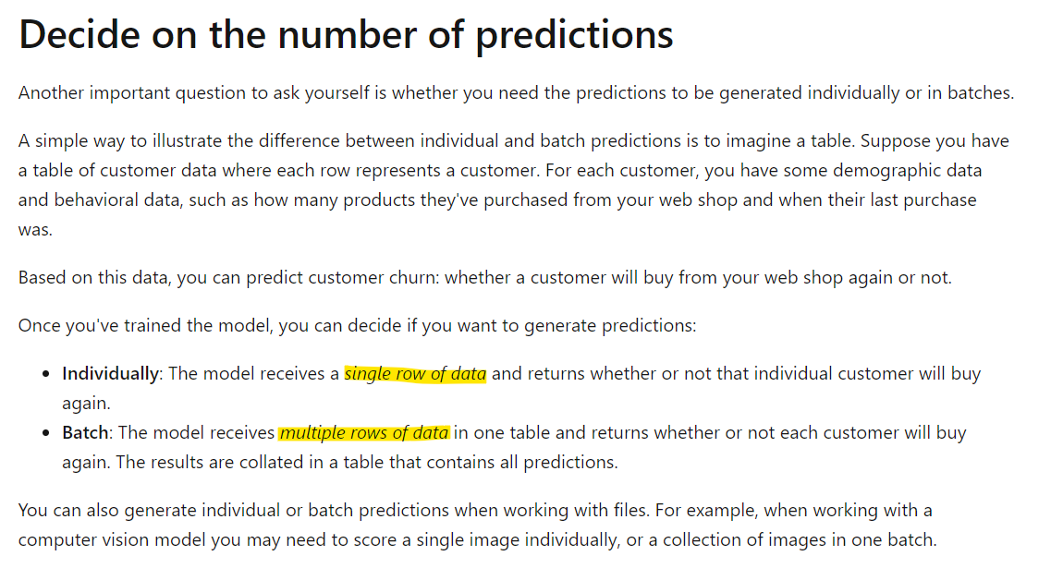
DP-100 Microsoft Azure Data Science
Microsoft Azure Data Science: Design a machine learning solution
Date: 18/10/24
Design a Model Deployment Solution
Read time vs batch

Slide 7
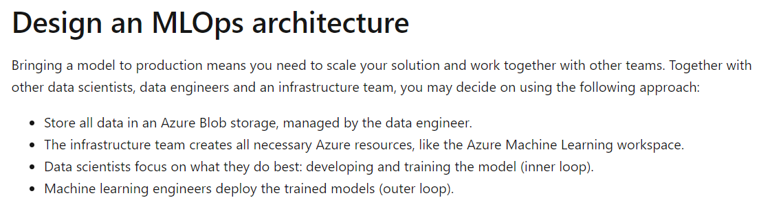
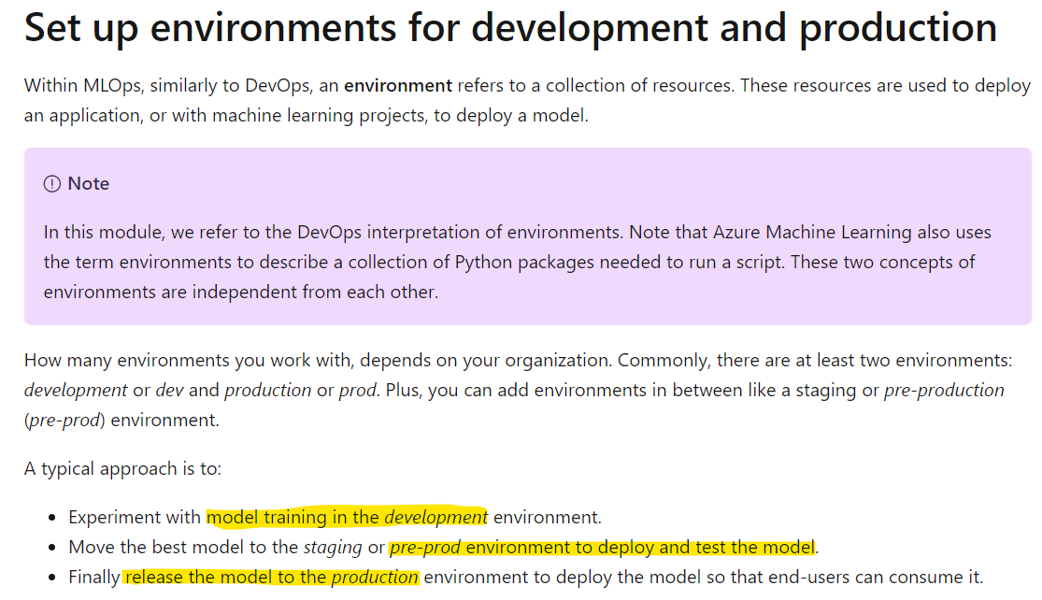
DP-100 Microsoft Azure Data Science
Microsoft Azure Data Science: Design a machine learning solution
Date: 18/10/24
Design an ML Ops Solution
Environments & Architecture

Slide 8
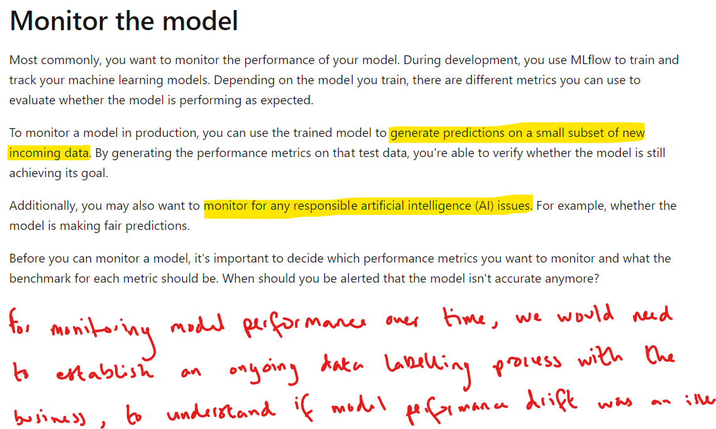
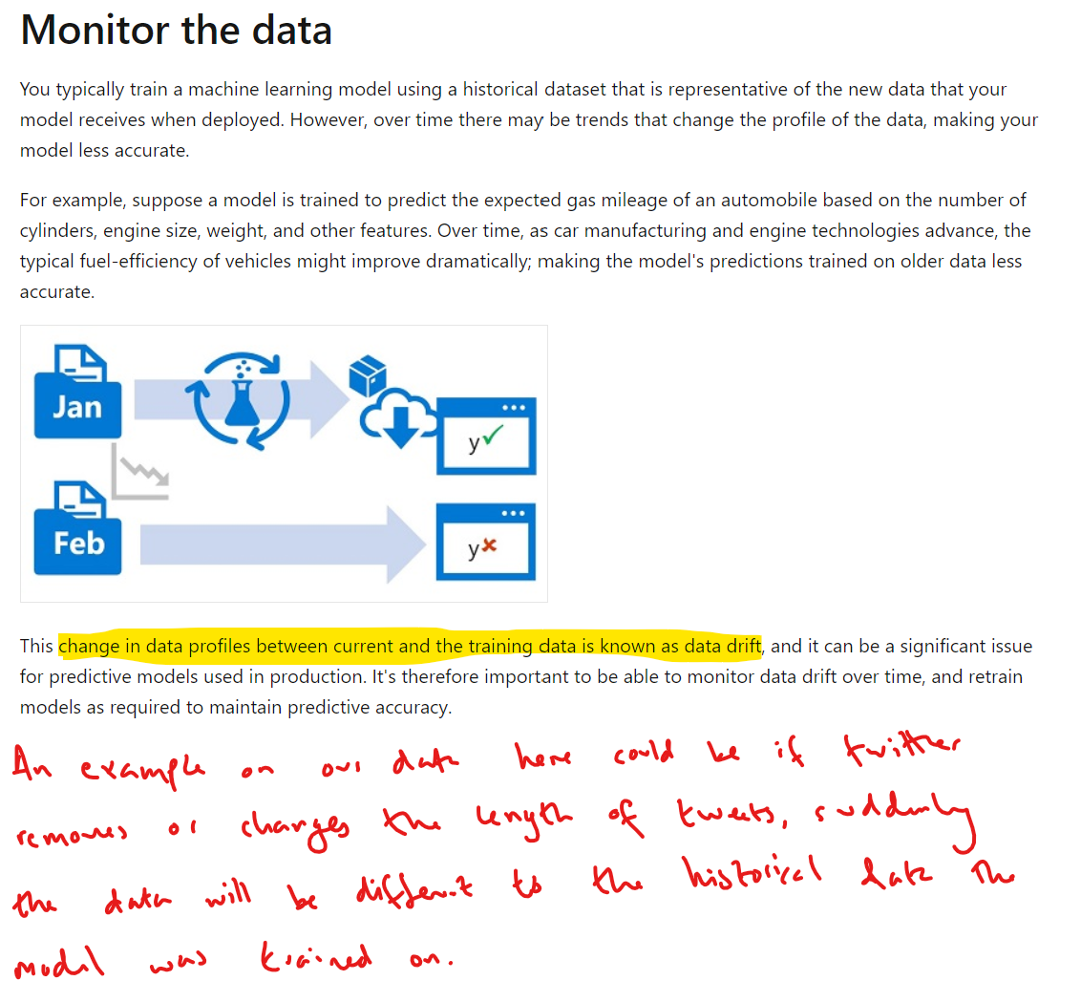
DP-100 Microsoft Azure Data Science
Microsoft Azure Data Science: Design a machine learning solution
Date: 18/10/24
Design an ML Ops Solution
Model Monitoring
“In essence, monitoring data drift can give you insights into potential issues before they affect model performance, while monitoring model performance drift helps you catch issues that might have already impacted the model.”
“Model performance drift, on the other hand, refers to changes in the model's performance over time. This can be due to data drift, but also other factors like changes in the model's environment or the relationships between input features and the target variable”

Slide 9
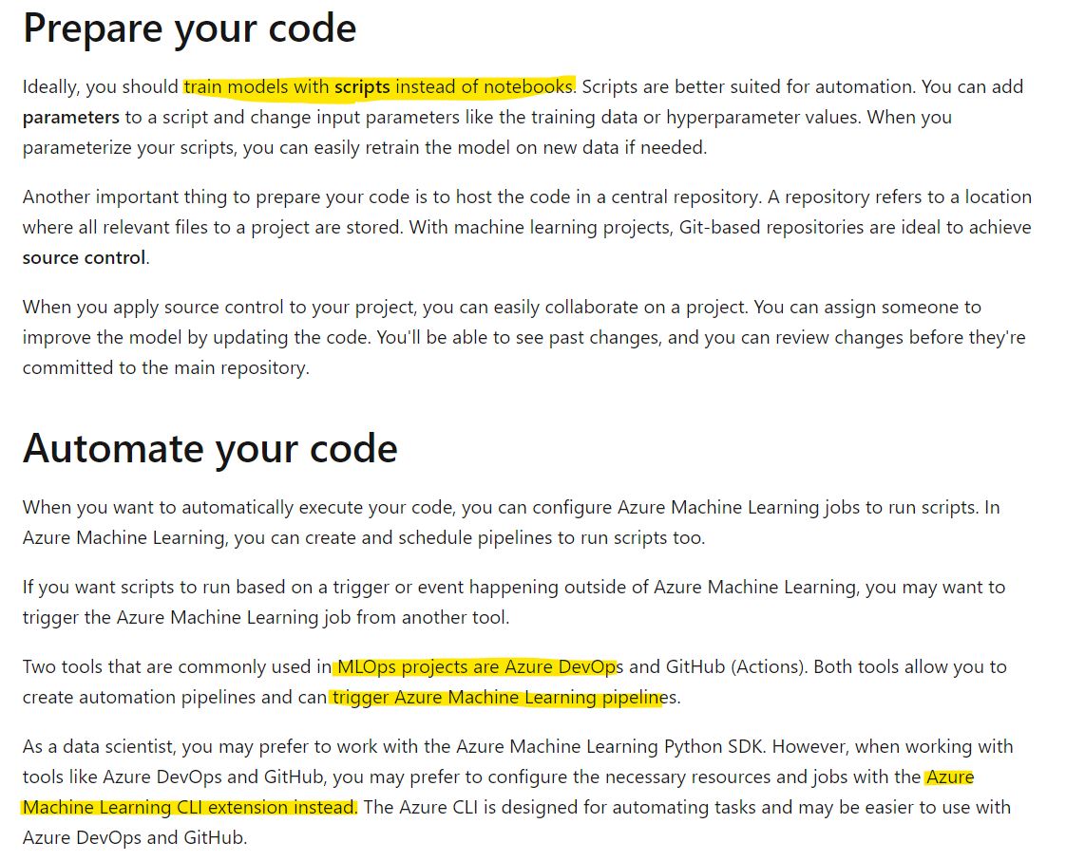
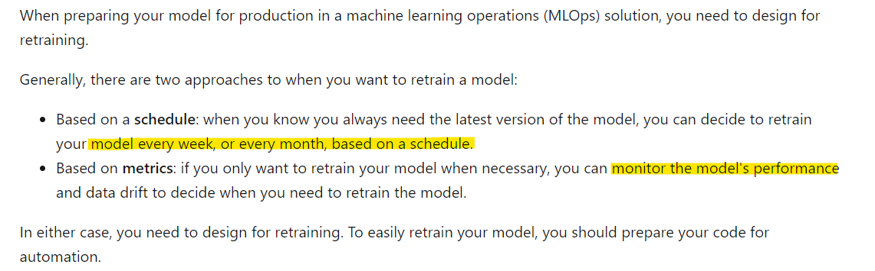
DP-100 Microsoft Azure Data Science
Microsoft Azure Data Science: Design a machine learning solution
Date: 18/10/24
Design an ML Ops Solution
Model Retraining

Slide 10
DP-100 Microsoft Azure Data Science
Microsoft Azure Data Science: Design a machine learning solution
Date: 18/10/24
Design an ML Ops Solution
Bonus Section on Containerisation & VMs
Container 1
OS A
Container 2
OS B
Container 3
OS A
The key difference between containers and VMs is containers share the underlying hardware via a shared OS kernel, whereas VMs split up the hardware on a single machine or server, such that the allocated resource to a single VM cannot share with another VM.
VM 1
OS A
VM 2
OS B
VM 3
OS C
Kernel
(Sometimes referred to as OS kernel)
Single machine or server with hardware split between VMs
Hardware
(CPU, GPU, RAM)
Hardware
(CPU, GPU, RAM)
Hardware
(CPU, GPU, RAM)
Hardware
(CPU, GPU, RAM)
https://www.ibm.com/topics/containerization

Slide 11
DP-100 Microsoft Azure Data Science
https://learn.microsoft.com/en-us/training/paths/explore-azure-machine-learning-workspace/
Section 2
Explore the Azure Machine Learning Workspace

Slide 12
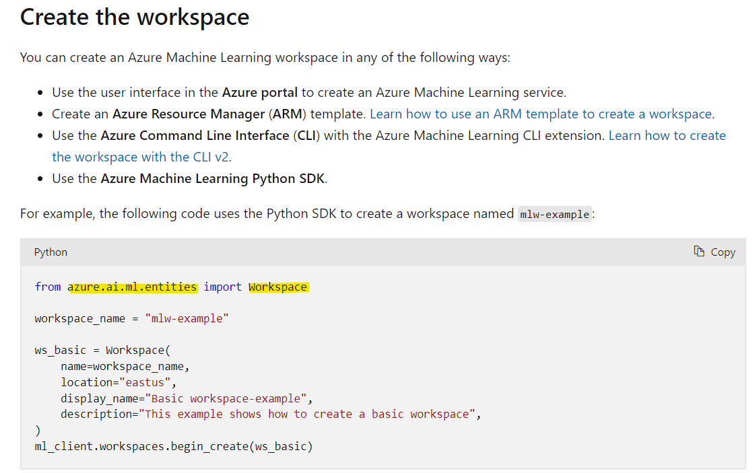
DP-100 Microsoft Azure Data Science
Microsoft Azure Data Science: Explore the Azure Machine Learning Workspace
Date: 18/10/24
Explore AML Workspace Resources & Assets
Creating & Interacting with the Workspace

Slide 13
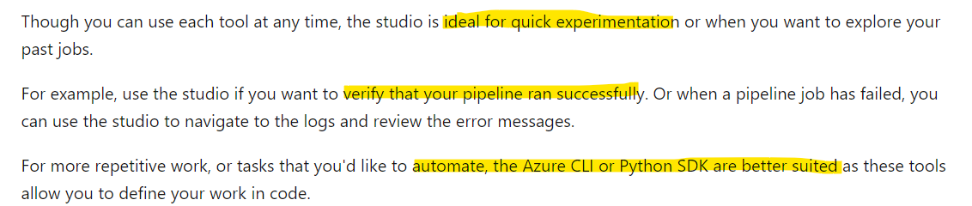
DP-100 Microsoft Azure Data Science
Microsoft Azure Data Science: Explore the Azure Machine Learning Workspace
Date: 18/10/24
Explore Developer Tools
Using the Studio to Interact
There are 3 ways we can interact with the workspace we’ve just created, these are:
Studio
Python SDK v2
Azure CLI
Studio

Slide 14
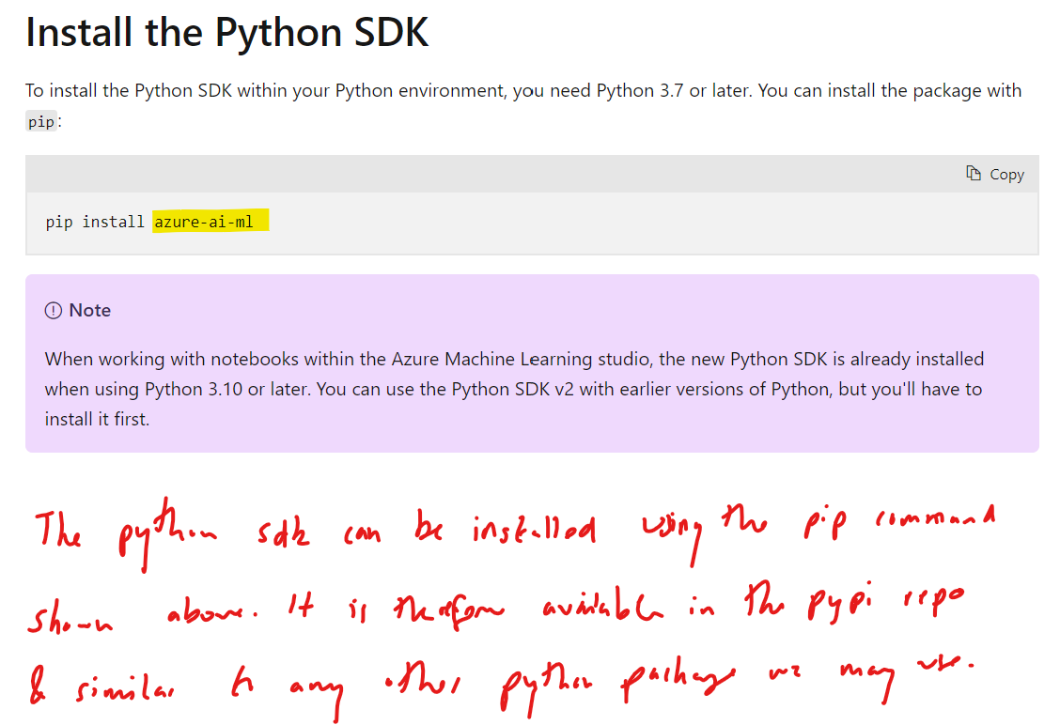
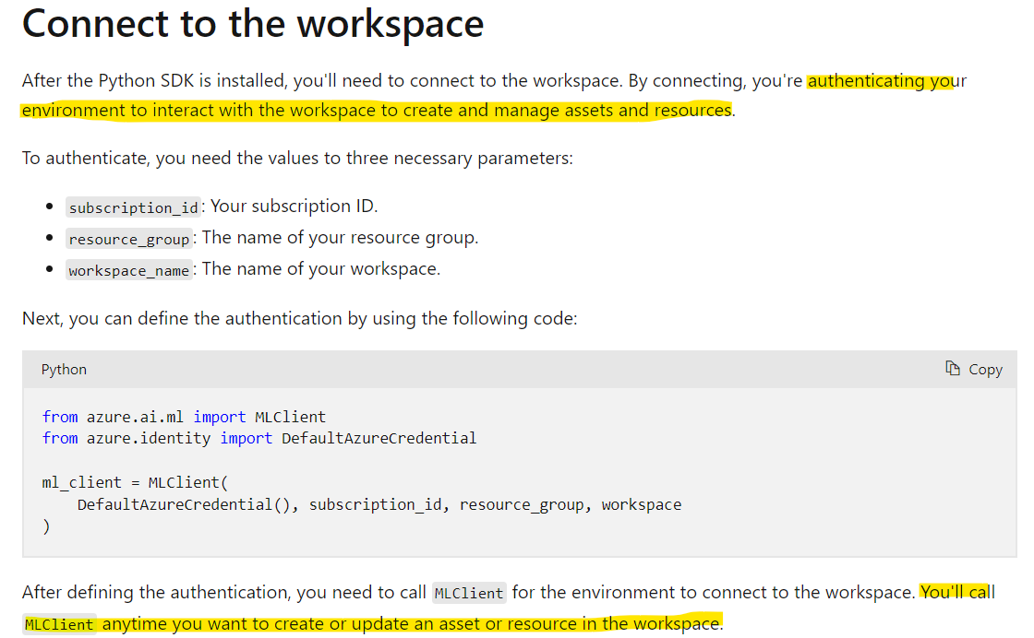
DP-100 Microsoft Azure Data Science
Microsoft Azure Data Science: Explore the Azure Machine Learning Workspace
Date: 18/10/24
Explore Developer Tools
Using the Python SDK to Interact

Slide 15
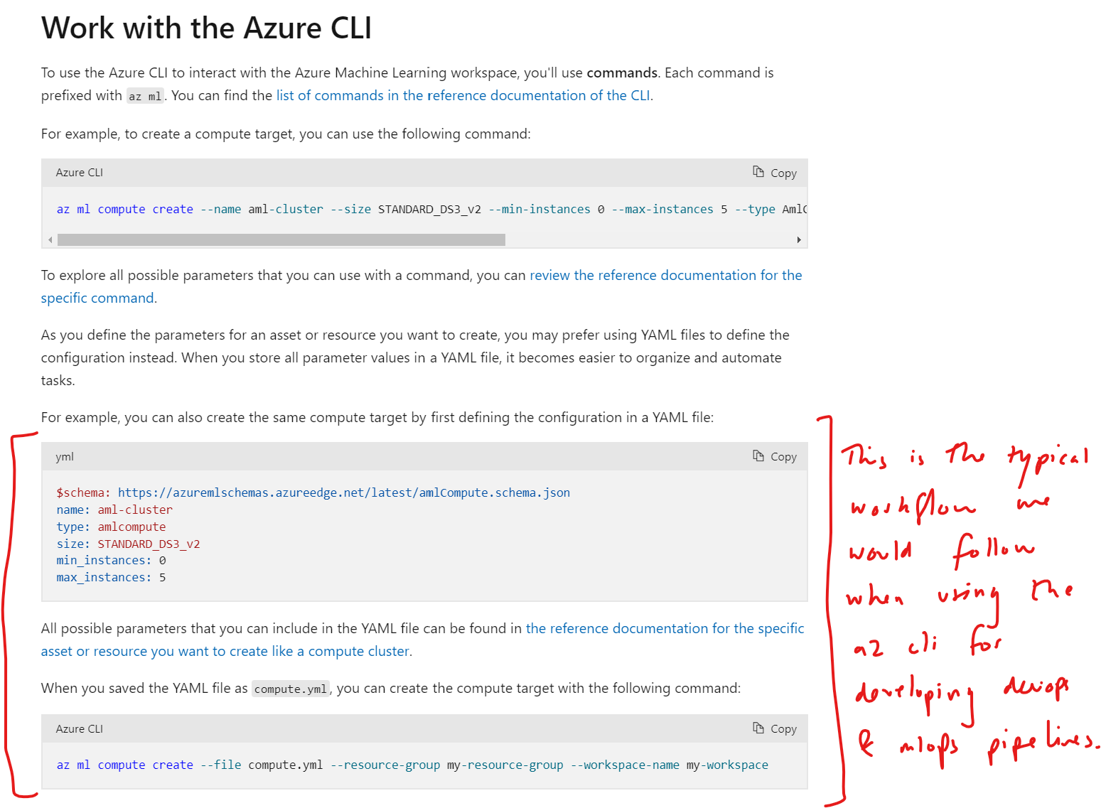
DP-100 Microsoft Azure Data Science
Microsoft Azure Data Science: Explore the Azure Machine Learning Workspace
Date: 18/10/24
Explore Developer Tools
Using the CLI to Interact

Slide 16
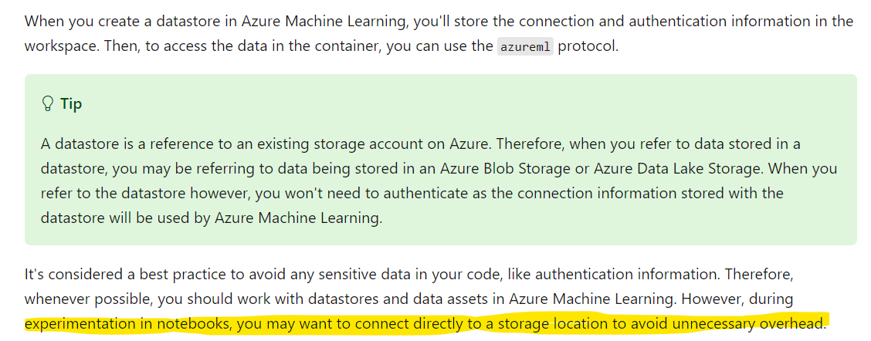
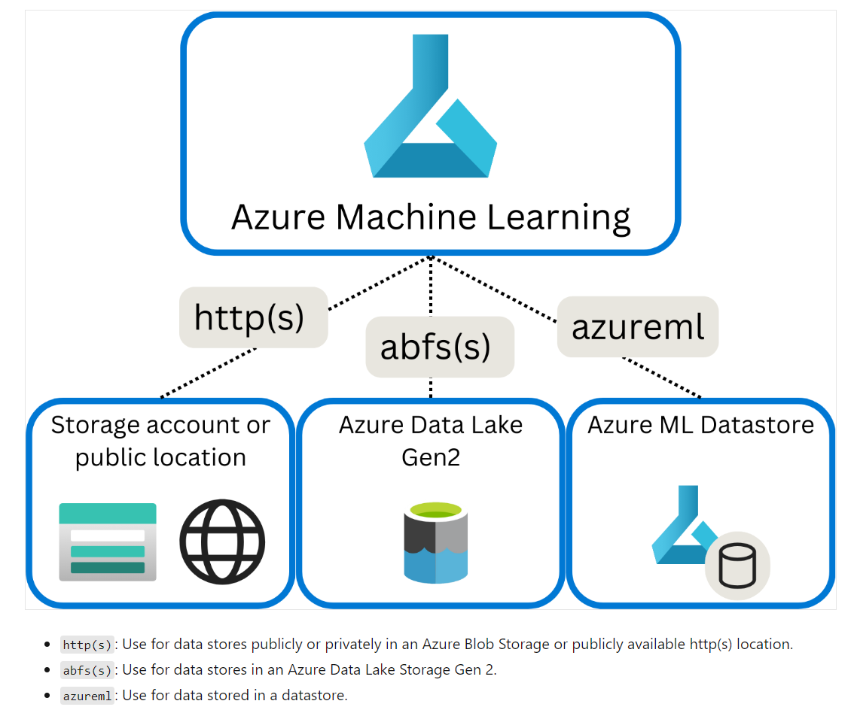
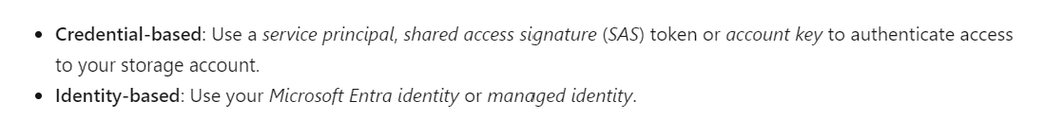
DP-100 Microsoft Azure Data Science
Microsoft Azure Data Science: Explore the Azure Machine Learning Workspace
Date: 18/10/24
Making Data Available in AML
Summary

Slide 17
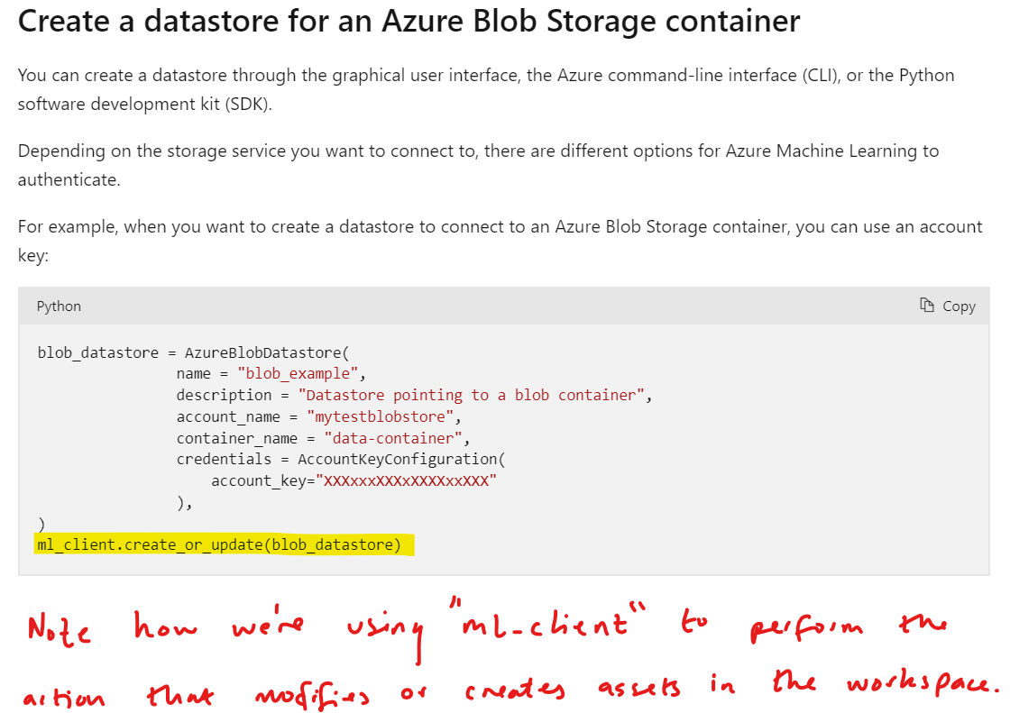
DP-100 Microsoft Azure Data Science
Microsoft Azure Data Science: Explore the Azure Machine Learning Workspace
Date: 18/10/24
Making Data Available in AML
Datastores

Slide 18
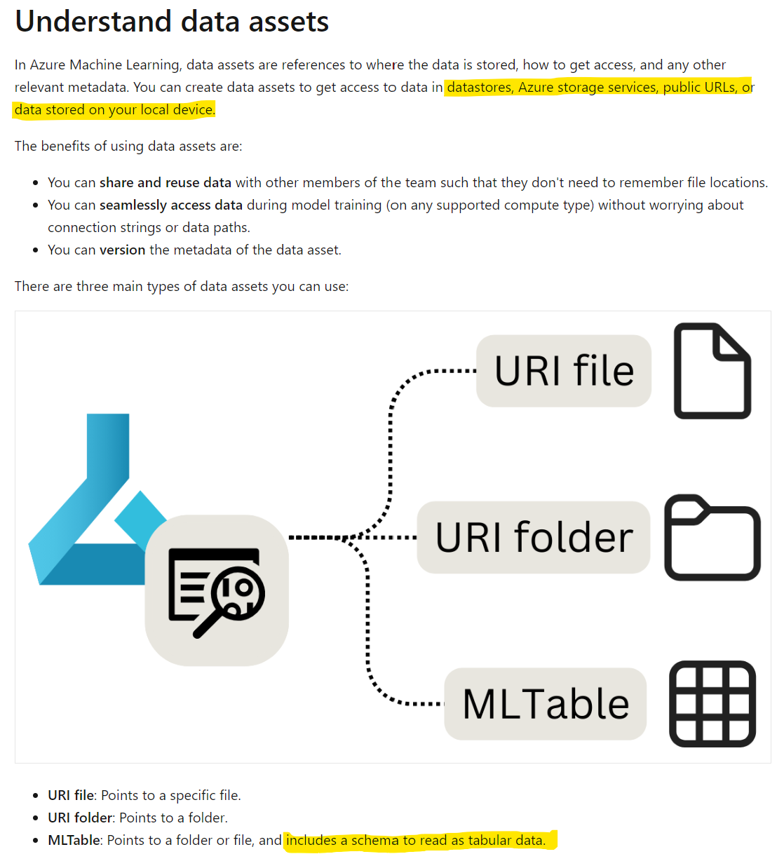
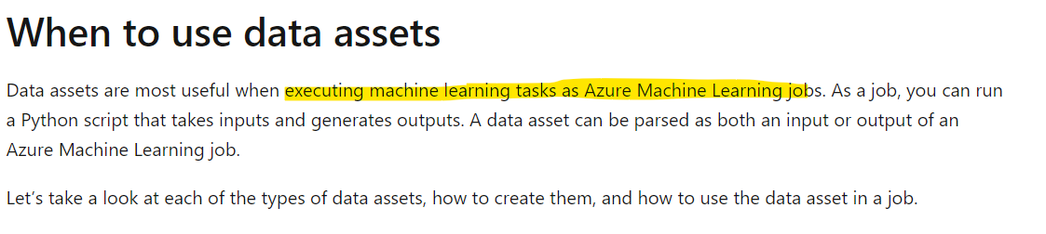
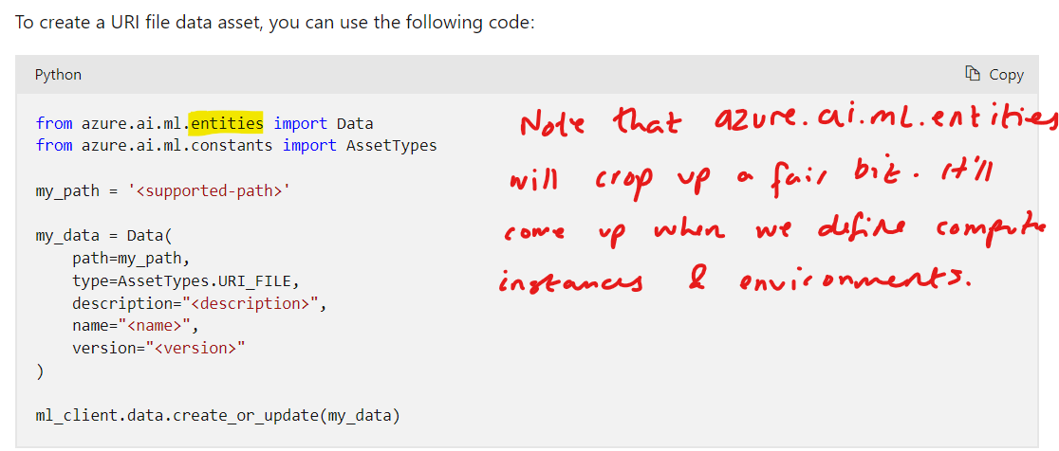
DP-100 Microsoft Azure Data Science
Microsoft Azure Data Science: Explore the Azure Machine Learning Workspace
Date: 18/10/24
Making Data Available in AML
Data Assets

Slide 19
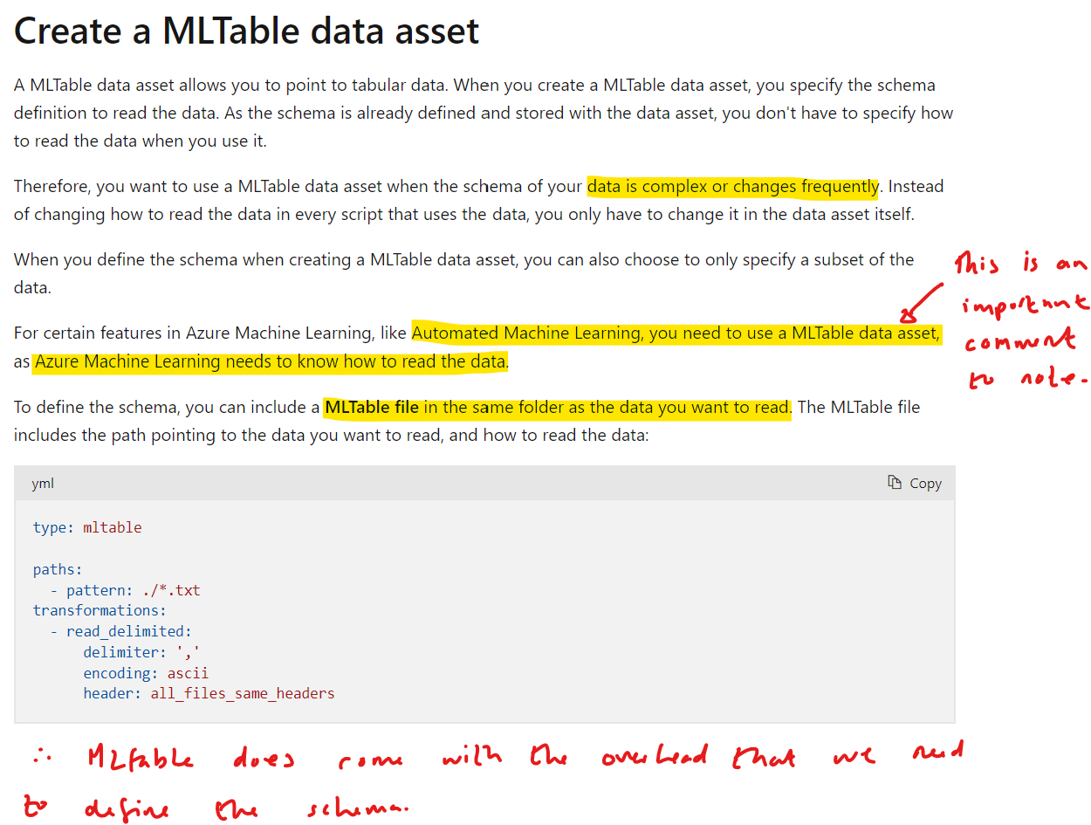
DP-100 Microsoft Azure Data Science
Microsoft Azure Data Science: Explore the Azure Machine Learning Workspace
Date: 18/10/24
Making Data Available in AML
Data Assets

Slide 20
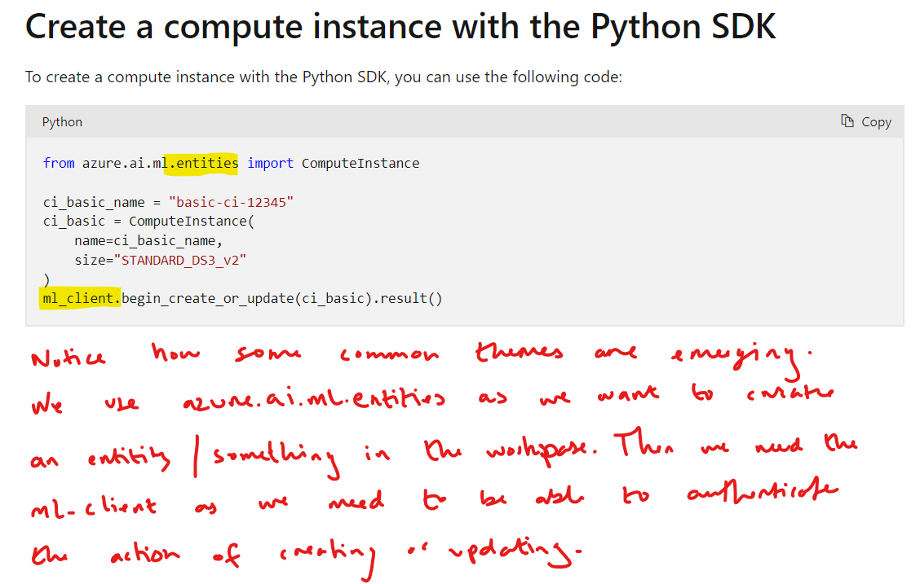
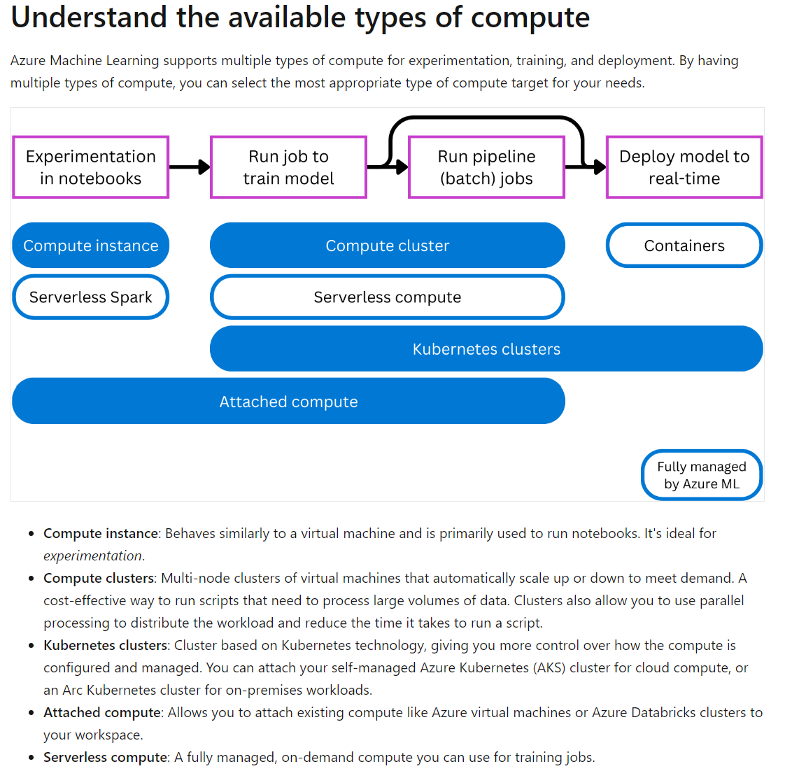
DP-100 Microsoft Azure Data Science
Microsoft Azure Data Science: Explore the Azure Machine Learning Workspace
Date: 18/10/24
Working with Compute in AML
Summary & Compute Instances

Slide 21
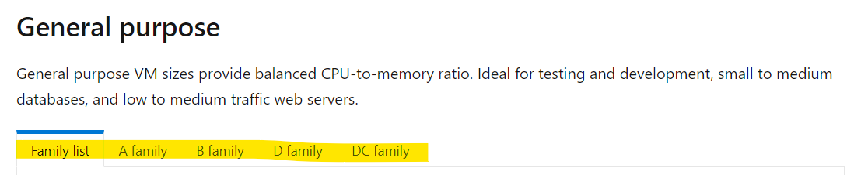
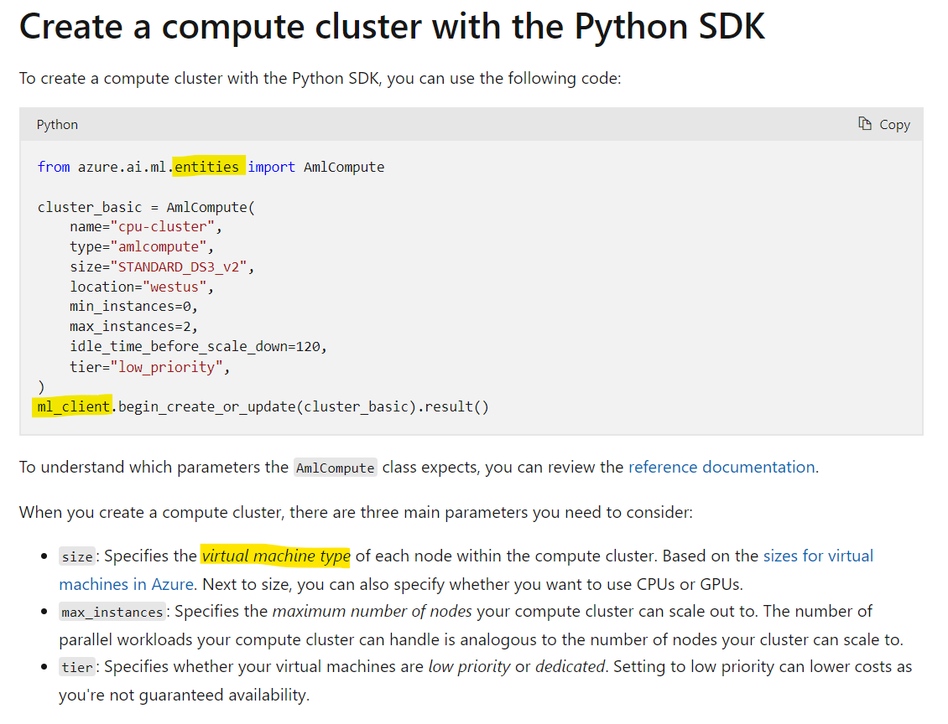
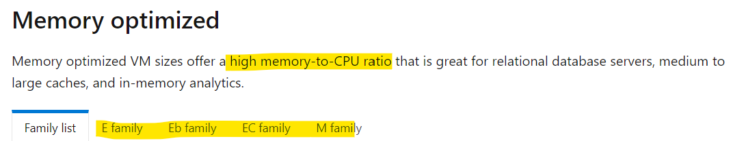
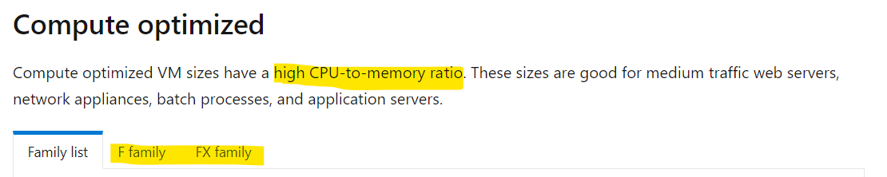
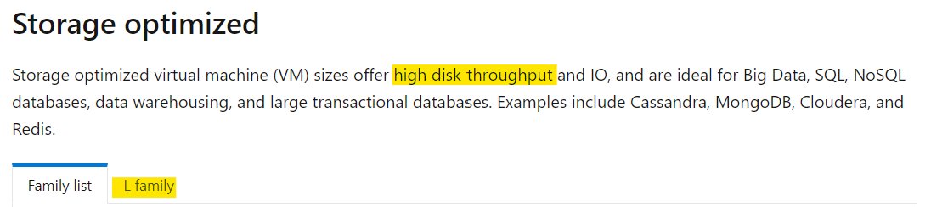
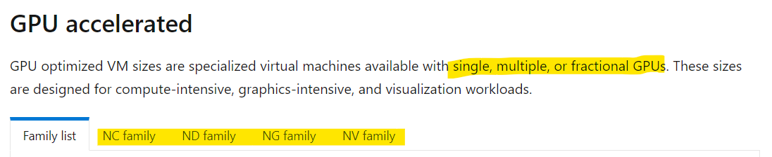
DP-100 Microsoft Azure Data Science
Microsoft Azure Data Science: Explore the Azure Machine Learning Workspace
Date: 18/10/24
Working with Compute in AML
Creating Compute Clusters
A, B, C, D
E
F
L
N

Slide 22
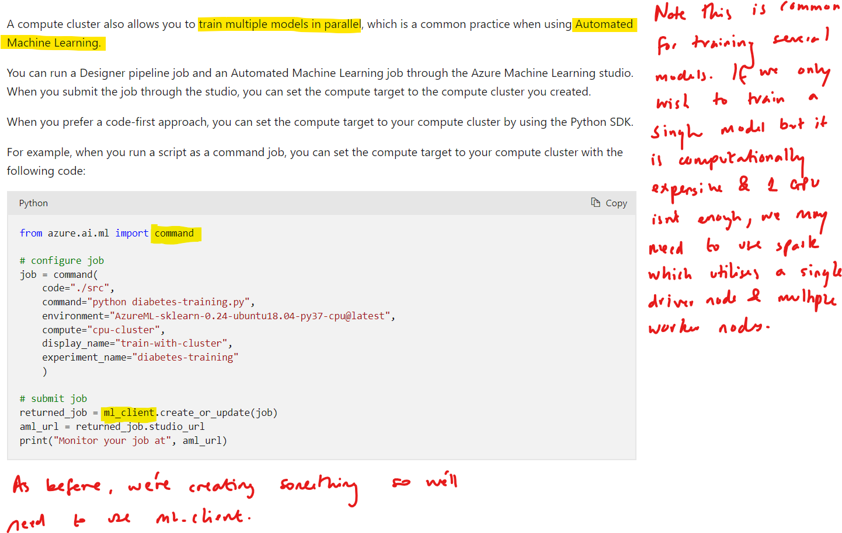
DP-100 Microsoft Azure Data Science
Microsoft Azure Data Science: Explore the Azure Machine Learning Workspace
Date: 18/10/24
Working with Compute in AML
Using Compute Clusters

Slide 23
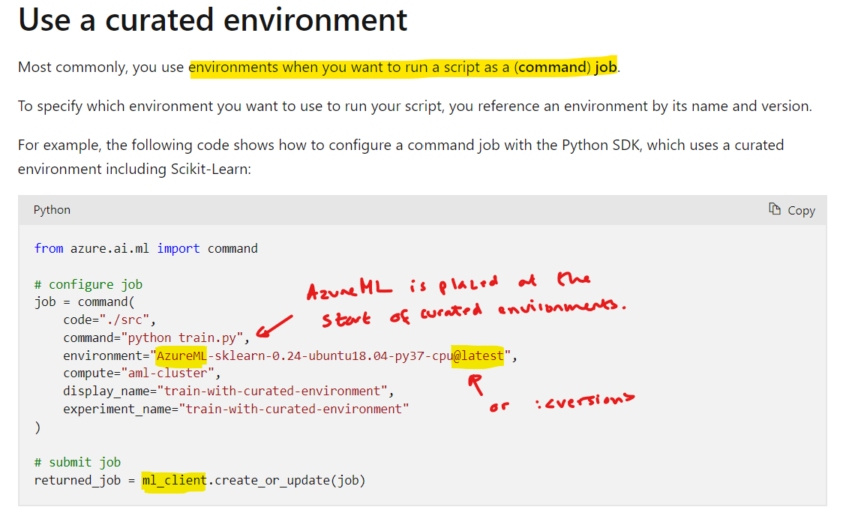
DP-100 Microsoft Azure Data Science
Microsoft Azure Data Science: Explore the Azure Machine Learning Workspace
Date: 18/10/24
Working with Environments in AML
Curated Environments

Slide 24
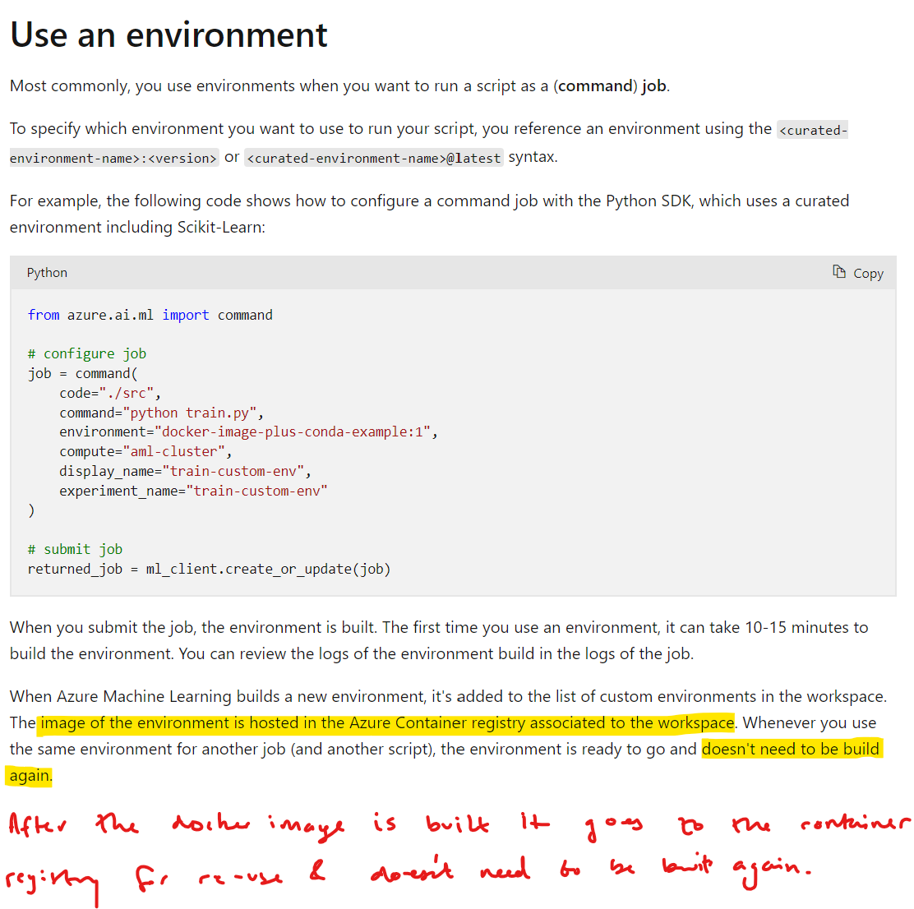
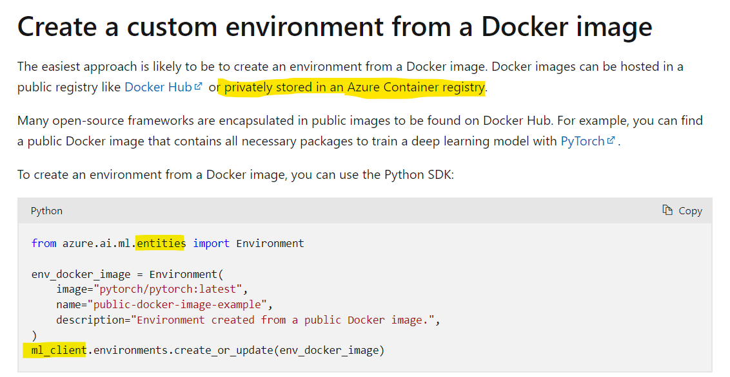
DP-100 Microsoft Azure Data Science
Microsoft Azure Data Science: Explore the Azure Machine Learning Workspace
Date: 18/10/24
Working with Environments in AML
Custom Environments

Slide 25
DP-100 Microsoft Azure Data Science
https://learn.microsoft.com/en-us/training/paths/automate-machine-learning-model-selection-azure-machine-learning/
Section 3
Experiment with Azure Machine Learning

Slide 26
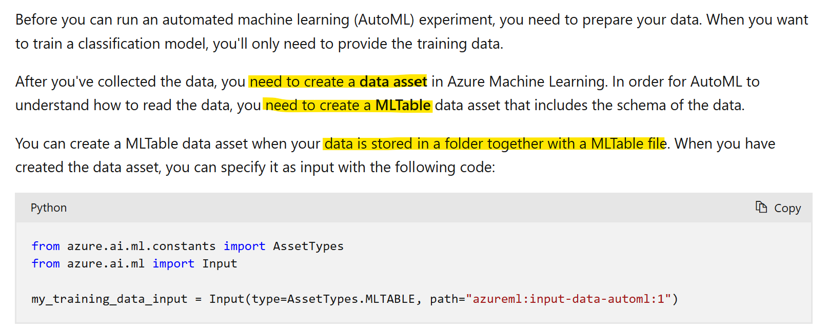
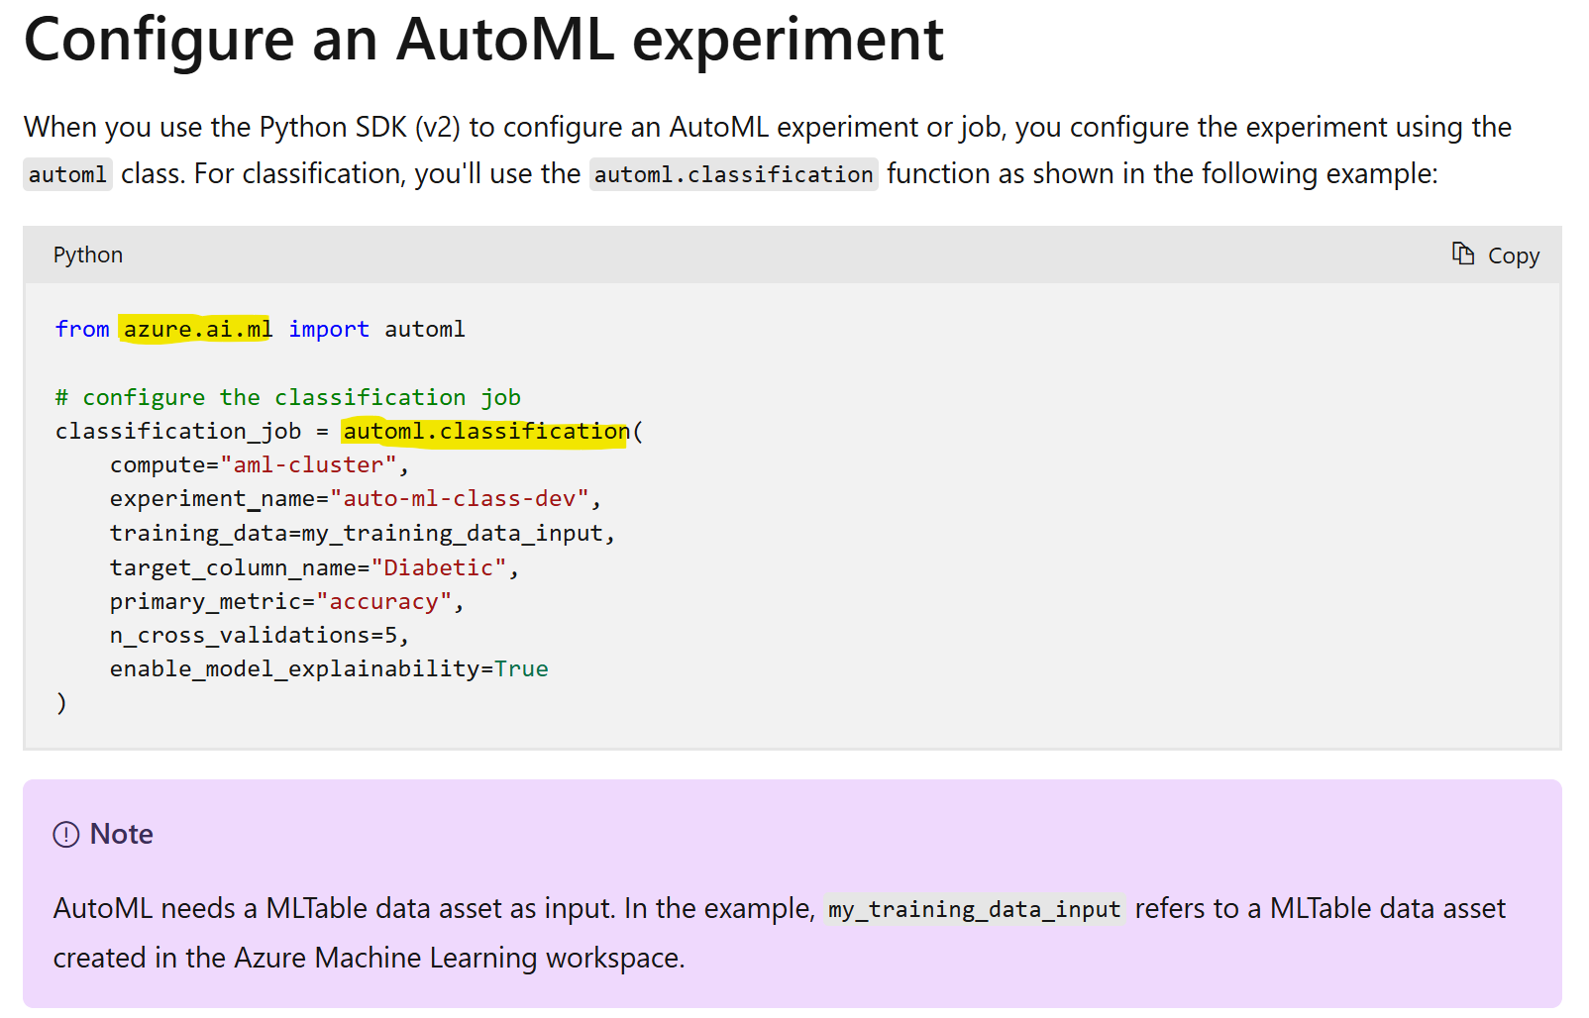
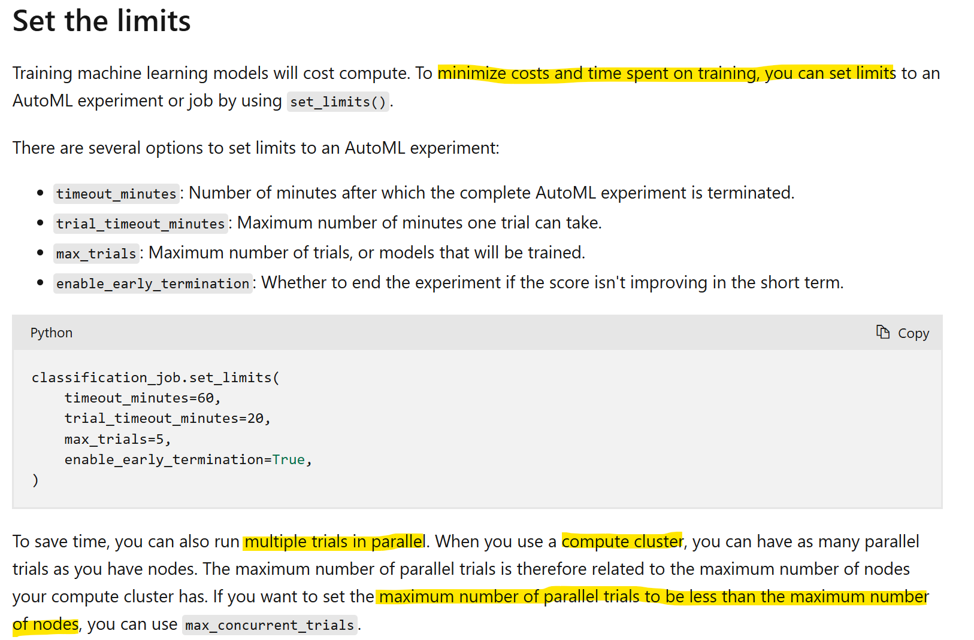
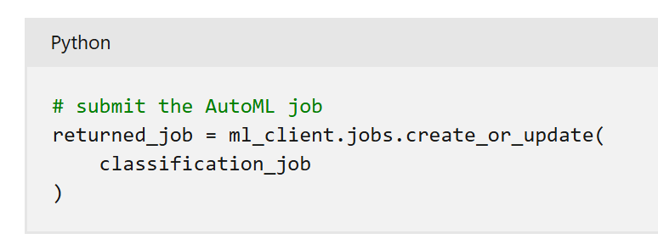
DP-100 Microsoft Azure Data Science
Microsoft Azure Data Science: Experiment with Azure Machine Learning
Date: 30/10/24
Find the Best Model in AML
AutoML Workflow – Python SDK
Register mltable data asset and load as input
Instantiate automl classification object
Use object methods to update the object with optional configuration
Instantiate an automl job

Slide 27
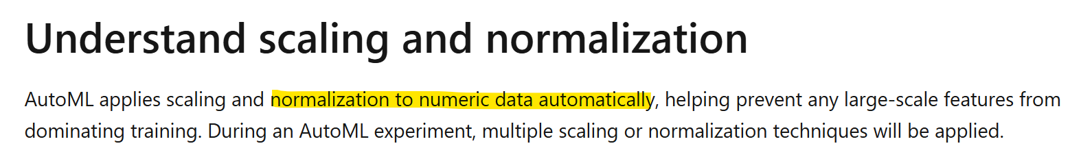
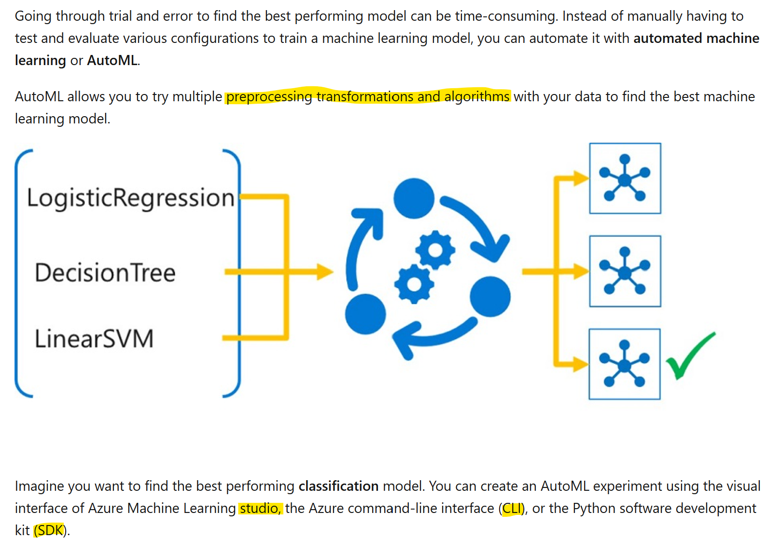
DP-100 Microsoft Azure Data Science
Microsoft Azure Data Science: Experiment with Azure Machine Learning
Date: 30/10/24
Find the Best Model in AML
AutoML Info & Requirements

Slide 28
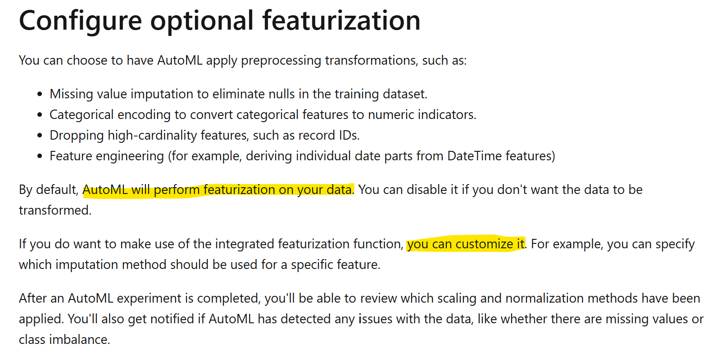
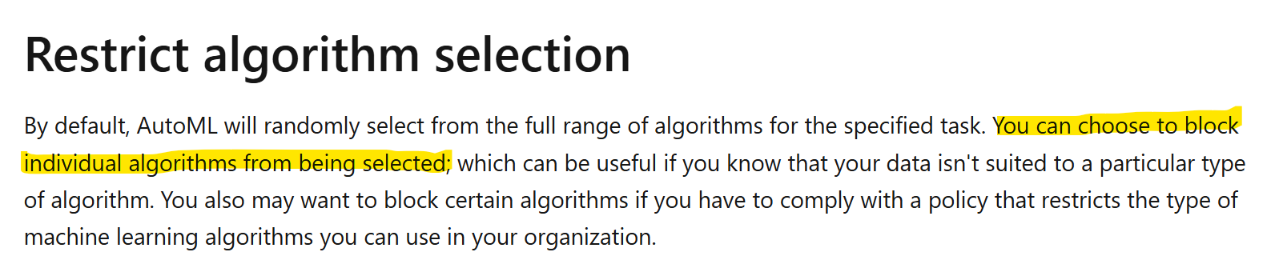
DP-100 Microsoft Azure Data Science
Microsoft Azure Data Science: Experiment with Azure Machine Learning
Date: 30/10/24
Find the Best Model in AML
Instantiating the AutoML Object

Slide 29
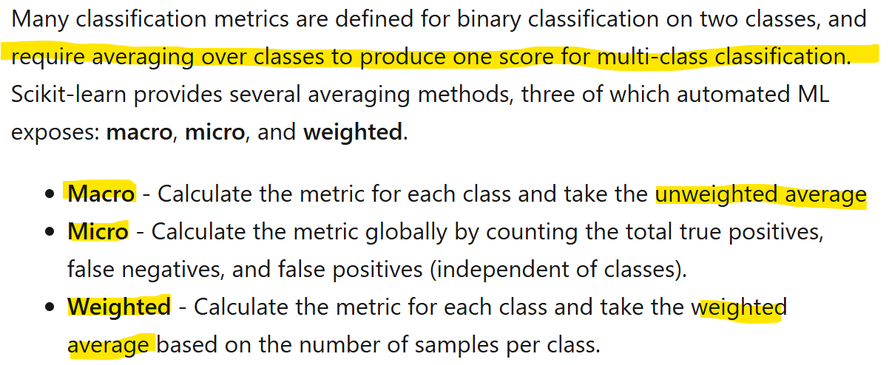
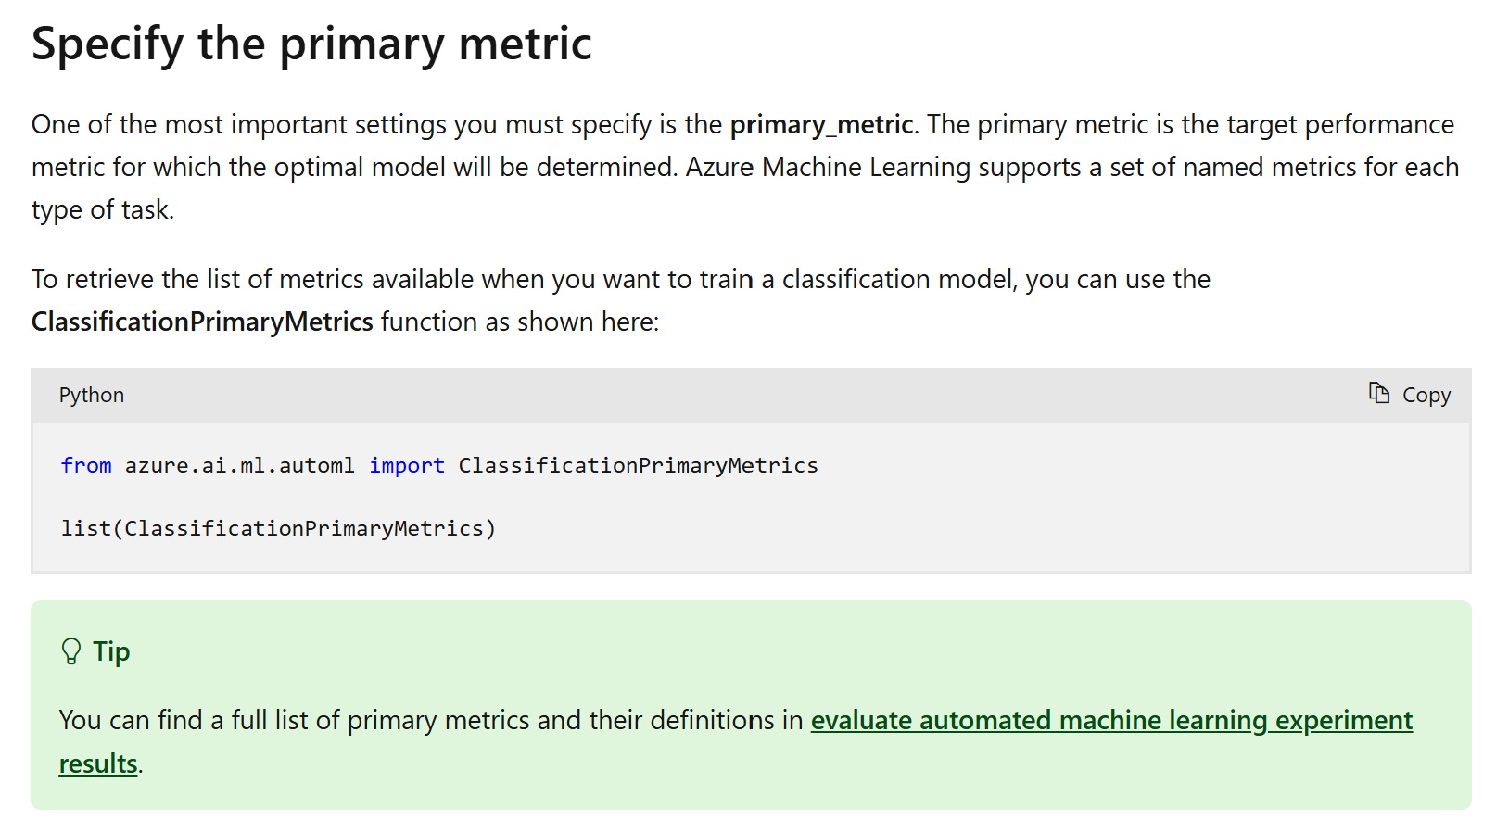
DP-100 Microsoft Azure Data Science
Microsoft Azure Data Science: Experiment with Azure Machine Learning
Date: 30/10/24
Find the Best Model in AML
AutoML Evaluation Metrics
Need to read up more on evaluation metrics:
https://learn.microsoft.com/en-us/azure/machine-learning/how-to-understand-automated-ml?view=azureml-api-2

Slide 30
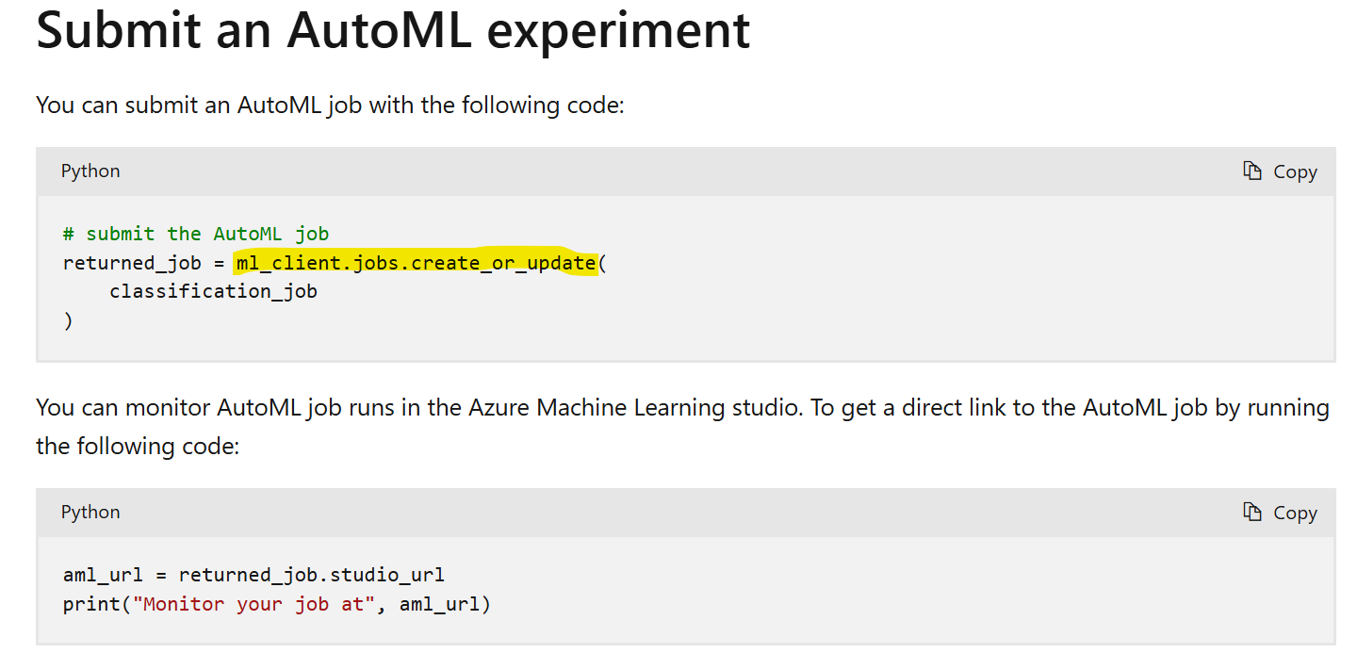
DP-100 Microsoft Azure Data Science
Microsoft Azure Data Science: Experiment with Azure Machine Learning
Date: 30/10/24
Find the Best Model in AML
AutoML Modifying Classification Object & Submitting Jobs

Slide 31



DP-100 Microsoft Azure Data Science
Microsoft Azure Data Science: Experiment with Azure Machine Learning
Date: 30/10/24
Find the Best Model in AML
AutoML Model Evaluation
Not a problem with ordinal features, they can stay as they are but nominal features even with moderate cardinality will result in too many features when one hot encoded.

Slide 32


DP-100 Microsoft Azure Data Science
Microsoft Azure Data Science: Experiment with Azure Machine Learning
Date: 15/11/24
MLFlow in Notebooks
Getting Setup

Slide 33


DP-100 Microsoft Azure Data Science
Microsoft Azure Data Science: Experiment with Azure Machine Learning
Date: 15/11/24
MLFlow in Notebooks
Running an Experiment

Slide 34
DP-100 Microsoft Azure Data Science
https://learn.microsoft.com/en-us/training/paths/use-azure-machine-learning-pipelines-for-automation/
Section 4
Optimize model training with Azure Machine Learning

Slide 35


DP-100 Microsoft Azure Data Science
Microsoft Azure Data Science: Optimize model training with Azure Machine Learning
Date: 15/11/24
Running Command Jobs
Configuring command jobs

Slide 36


DP-100 Microsoft Azure Data Science
Microsoft Azure Data Science: Optimize model training with Azure Machine Learning
Date: 15/11/24
Running Command Jobs
Parameterising and re-using scripts

Slide 37


DP-100 Microsoft Azure Data Science
Microsoft Azure Data Science: Optimize model training with Azure Machine Learning
Date: 15/11/24
MLFlow in Command Jobs
Configuring the mlflow experiment

Slide 38



DP-100 Microsoft Azure Data Science
Microsoft Azure Data Science: Optimize model training with Azure Machine Learning
Date: 15/11/24
MLFlow in Command Jobs
Reviewing mlflow experiments – studio
https://learn.microsoft.com/en-us/azure/machine-learning/how-to-use-mlflow-cli-runs?view=azureml-api-2&tabs=interactive%2Ccli

Slide 39

DP-100 Microsoft Azure Data Science
Microsoft Azure Data Science: Optimize model training with Azure Machine Learning
Date: 15/11/24
MLFlow in Command Jobs
Reviewing mlflow experiments – studio
https://learn.microsoft.com/en-us/azure/machine-learning/how-to-use-mlflow-cli-runs?view=azureml-api-2&tabs=interactive%2Ccli

Slide 40


DP-100 Microsoft Azure Data Science
Microsoft Azure Data Science: Optimize model training with Azure Machine Learning
Date: 15/11/24
MLFlow in Command Jobs
Reviewing mlflow experiments - Notebooks

Slide 41





DP-100 Microsoft Azure Data Science
Microsoft Azure Data Science: Optimize model training with Azure Machine Learning
Date: 15/11/24
Hyperparameter Tuning in AML
Defining a Search Space
Uniform
Normal
LogUniform
LogNormal

Slide 42

DP-100 Microsoft Azure Data Science
Microsoft Azure Data Science: Optimize model training with Azure Machine Learning
Date: 15/11/24
Hyperparameter Tuning in AML
Defining a Search Space

Slide 43




DP-100 Microsoft Azure Data Science
Microsoft Azure Data Science: Optimize model training with Azure Machine Learning
Date: 15/11/24
Hyperparameter Tuning in AML
Sampling Methods

Slide 44


DP-100 Microsoft Azure Data Science
Microsoft Azure Data Science: Optimize model training with Azure Machine Learning
Date: 15/11/24
Hyperparameter Tuning in AML
Configuring ‘Early’ Termination

Slide 45



DP-100 Microsoft Azure Data Science
Microsoft Azure Data Science: Optimize model training with Azure Machine Learning
Date: 15/11/24
Hyperparameter Tuning in AML
Configuring ‘Early’ Termination
It strikes me these three stopping policies only seem appropriate where the sampling method should produce results which are expected to improve. If we select a random sampling method, any of these three termination methodologies could result in very early termination.

Slide 46



DP-100 Microsoft Azure Data Science
Microsoft Azure Data Science: Optimize model training with Azure Machine Learning
Date: 15/11/24
Hyperparameter Tuning in AML
Running our Sweep Job

Slide 47


DP-100 Microsoft Azure Data Science
Microsoft Azure Data Science: Optimize model training with Azure Machine Learning
Date: 15/11/24
Run Pipelines in AML
Creating Components

Slide 48


DP-100 Microsoft Azure Data Science
Microsoft Azure Data Science: Optimize model training with Azure Machine Learning
Date: 15/11/24
Run Pipelines in AML
Creating Components – An Example

Slide 49


DP-100 Microsoft Azure Data Science
Microsoft Azure Data Science: Optimize model training with Azure Machine Learning
Date: 15/11/24
Run Pipelines in AML
Building a Pipeline

Slide 50



DP-100 Microsoft Azure Data Science
Microsoft Azure Data Science: Optimize model training with Azure Machine Learning
Date: 15/11/24
Run Pipelines in AML
Running a Pipeline

Slide 51
DP-100 Microsoft Azure Data Science
https://learn.microsoft.com/en-us/training/paths/manage-review-models-azure-machine-learning/
Section 5
Manage and review models in Azure Machine Learning

Slide 52



DP-100 Microsoft Azure Data Science
Microsoft Azure Data Science: Manage and review models in Azure Machine Learning
Date: 29/11/24
Registering MLFlow Models
Log Model vs Log Artifact vs Save Model
https://learn.microsoft.com/en-us/azure/machine-learning/concept-mlflow-models?view=azureml-api-2#the-mlmodel-format?azure-portal=true

Slide 53




DP-100 Microsoft Azure Data Science
Microsoft Azure Data Science: Manage and review models in Azure Machine Learning
Date: 29/11/24
Registering MLFlow Models
Logging Model with Autolog

Slide 54


DP-100 Microsoft Azure Data Science
Microsoft Azure Data Science: Manage and review models in Azure Machine Learning
Date: 29/11/24
Registering MLFlow Models
Registering

Slide 55



DP-100 Microsoft Azure Data Science
Microsoft Azure Data Science: Manage and review models in Azure Machine Learning
Date: 29/11/24
Responsible AI Dashboard
Understanding Responsible AI

Slide 56


DP-100 Microsoft Azure Data Science
Microsoft Azure Data Science: Manage and review models in Azure Machine Learning
Date: 29/11/24
Responsible AI Dashboard
Creating the Dashboard

Slide 57


DP-100 Microsoft Azure Data Science
Microsoft Azure Data Science: Manage and review models in Azure Machine Learning
Date: 29/11/24
Responsible AI Dashboard
Creating the Dashboard

Slide 58



DP-100 Microsoft Azure Data Science
Microsoft Azure Data Science: Manage and review models in Azure Machine Learning
Date: 29/11/24
Responsible AI Dashboard
Viewing the Dashboard

Slide 59
DP-100 Microsoft Azure Data Science
https://learn.microsoft.com/en-us/training/paths/deploy-consume-models-azure-machine-learning/
Section 6
Deploy and consume models with Azure Machine Learning

Slide 60


DP-100 Microsoft Azure Data Science
Microsoft Azure Data Science: Deploy and consume models with Azure Machine Learning
Date: 29/11/24
Online Endpoints
Creating Endpoints

Slide 61


DP-100 Microsoft Azure Data Science
Microsoft Azure Data Science: Deploy and consume models with Azure Machine Learning
Date: 29/11/24
Online Endpoints
Creating Deployments

Slide 62



DP-100 Microsoft Azure Data Science
Microsoft Azure Data Science: Deploy and consume models with Azure Machine Learning
Date: 29/11/24
Online Endpoints
Creating Custom Deployments

Slide 63


DP-100 Microsoft Azure Data Science
Microsoft Azure Data Science: Deploy and consume models with Azure Machine Learning
Date: 29/11/24
Online Endpoints
Testing our Deployments

Slide 64



DP-100 Microsoft Azure Data Science
Microsoft Azure Data Science: Deploy and consume models with Azure Machine Learning
Date: 29/11/24
Batch Endpoints
Creating Batch Endpoints & Deployments

Slide 65



DP-100 Microsoft Azure Data Science
Microsoft Azure Data Science: Deploy and consume models with Azure Machine Learning
Date: 29/11/24
Batch Endpoints
Creating Custom Deployments

Slide 66



DP-100 Microsoft Azure Data Science
Microsoft Azure Data Science: Deploy and consume models with Azure Machine Learning
Date: 29/11/24
Batch Endpoints
Invoking the Endpoint

